Slide 1
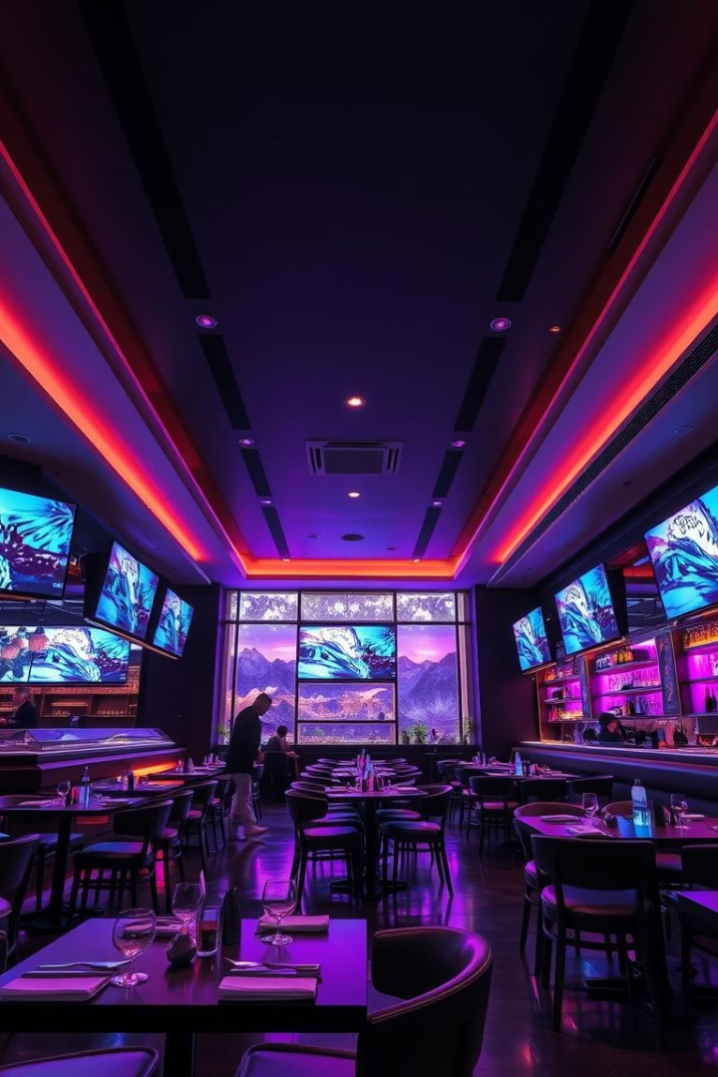
Java Restaurant Management System
Streamline operations and enhance customer experience with our Java-based solution. Built using JavaFX and core OOP principles for robustness and scalability.
Made by:
Armen Meliksetyan
Davit Baghdasaryan
Rafayel Manasyan

Slide 2
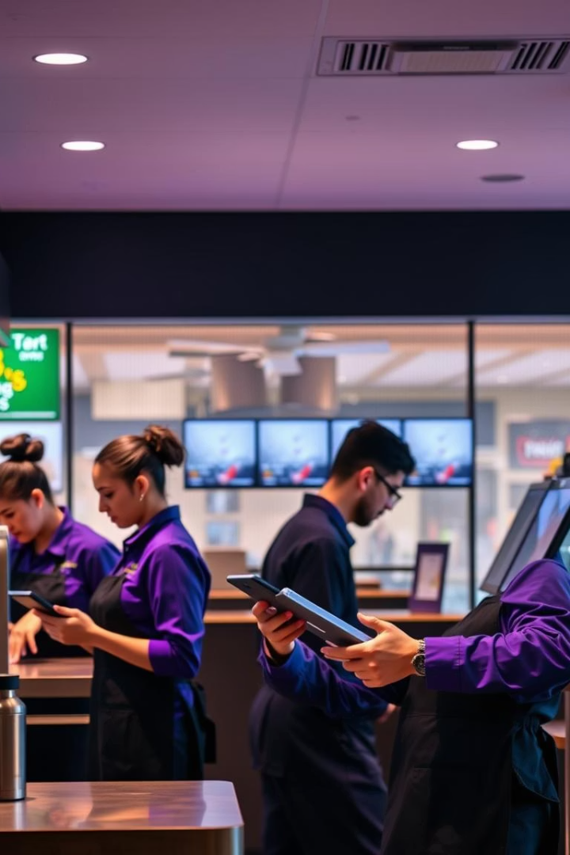
Project Overview and Purpose
Modernize Management
Centralized System
Automate ordering, inventory, and reporting processes.
Improve efficiency and accuracy across all operations.
Scalable Architecture
Built to easily support future growth and features.

Slide 3
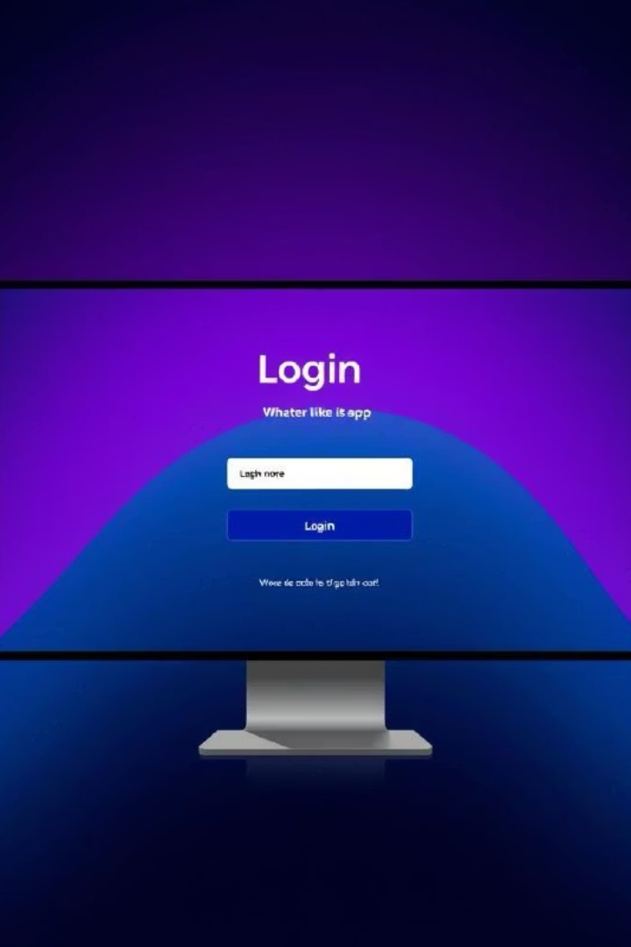

Core Feature: Login/Registration
Unified Interface
Role-Based Authentication
Simplifies onboarding by combining login and registration screens.
Differentiates Admin and Customer privileges securely.
Secure Password Management
Employs best practices for storing and validating passwords.

Slide 4
Role-Based Access
Admin Role
Customer Role
Full control over menu and orders
Place and track orders
Manage users and data
View order history
Access detailed reports
Browse menu seamlessly

Slide 5

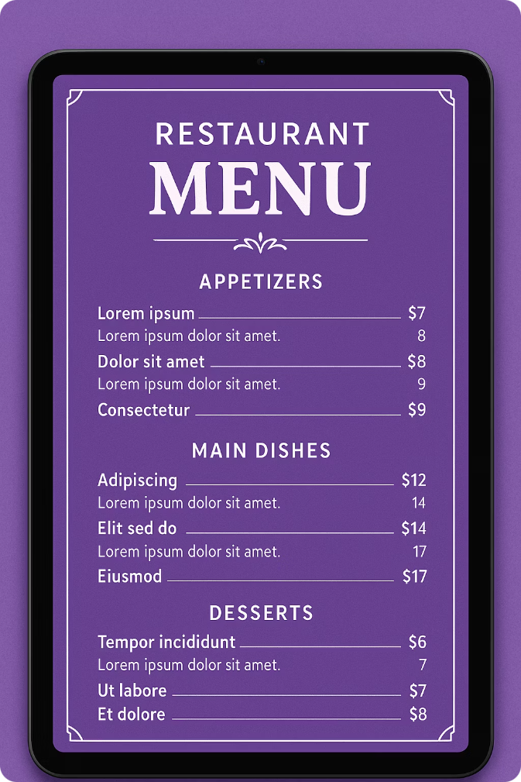
Key Feature: Menu Management
Dynamic Menu
Create and update items easily.
Clear Categorization
Organize dishes into appetizers, entrees, desserts, and beverages.
Detailed Descriptions
Provide ingredients and dish highlights for customers.

Slide 6
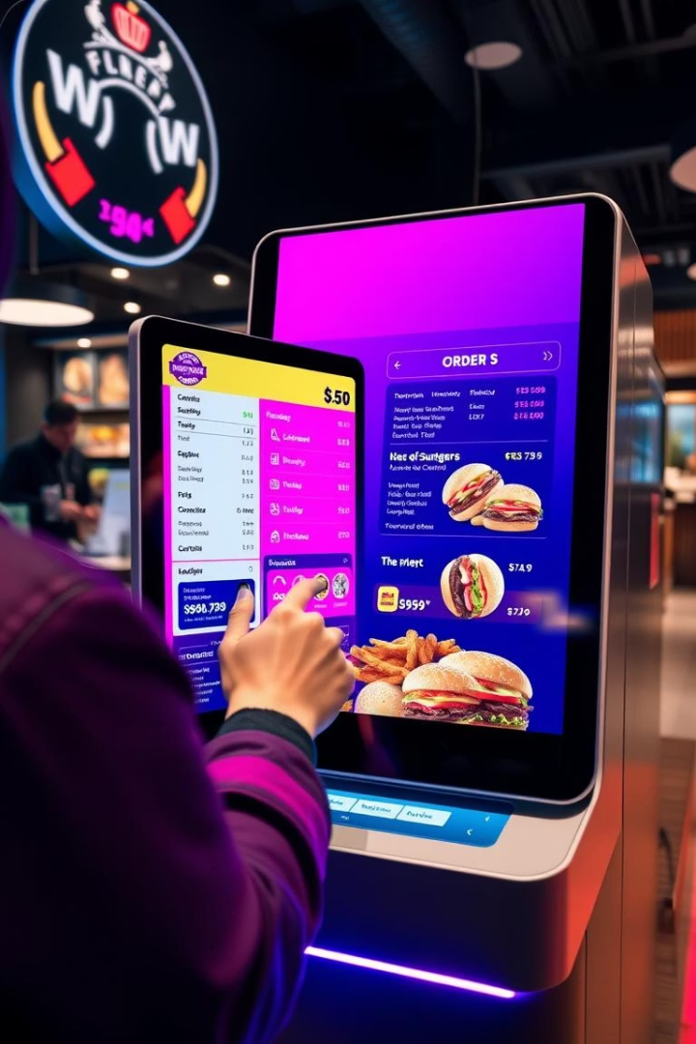


Key Feature: Order Creation
Intuitive Interface
Streamlined process for quick order placement.
Real-Time Tracking
Monitor order status updates instantly.

Slide 7





OOP Principles in Action
Encapsulation
Abstraction
Inheritance
Protect data within classes for security.
Simplify complex components into clear interfaces.
Reuse components for faster development.
Polymorphism
Adapt behavior based on roles and items.

Slide 8
Conclusion
Our Java-based system offers efficiency, security, and scalability to meet restaurant needs.
User-friendly design empowers both staff and customers. The system is ready for ongoing expansion.

Slide 9
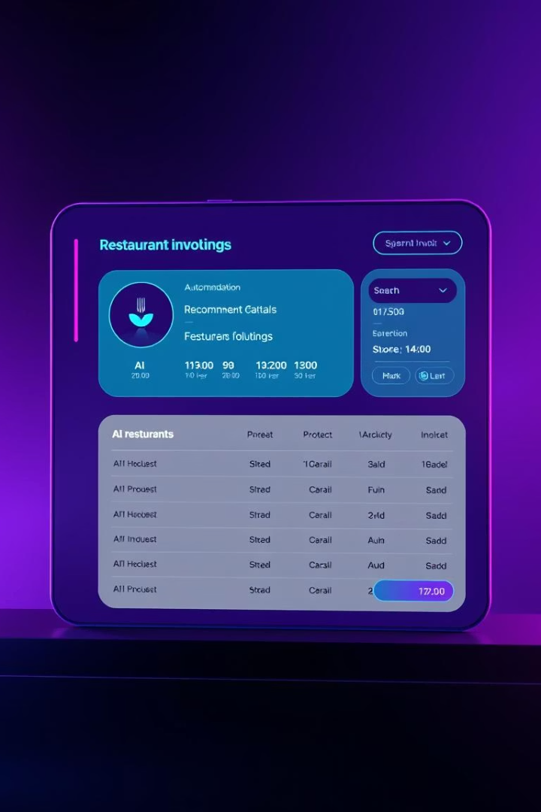
Future Expansion
Automatic invoice generation for seamless billing.
Integrated inventory management for stock control.
AI-powered menu and order recommendations.
Customer feedback system to improve service.

